Slide 1
Microservices and DevOps
DevOps and Container Technology
REST Architectural Style
Henrik Bærbak Christensen

Slide 2
REST: The Fast Version
Assuming you already know REST ☺

Slide 3
Architectural Style
As a software architect, I see REST as an
Architectural style / pattern
It is a specific programming model
Functional programming:
Computation is passing data through chains of functions
Object programming:
Computation is community of objects passing messages
RPC over Client-Server:
Computation is clients invoking procedures on remote servers
REST
Computation is clients manipulating resources using CRUD ops and moving through states using hypermedia links

Slide 4
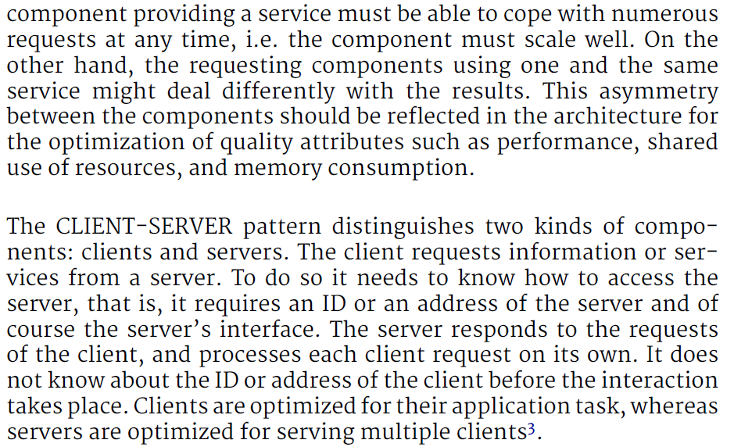
The Basics: Client-Server
Well defined roles of components and connectors…
Reactive
Server
Active
Client
Client
Client
Client
Client
Ala: web browsing, facebook, …
Notes:
NOB Web of Things, Henrik Korsgaard Praksis,

Slide 5
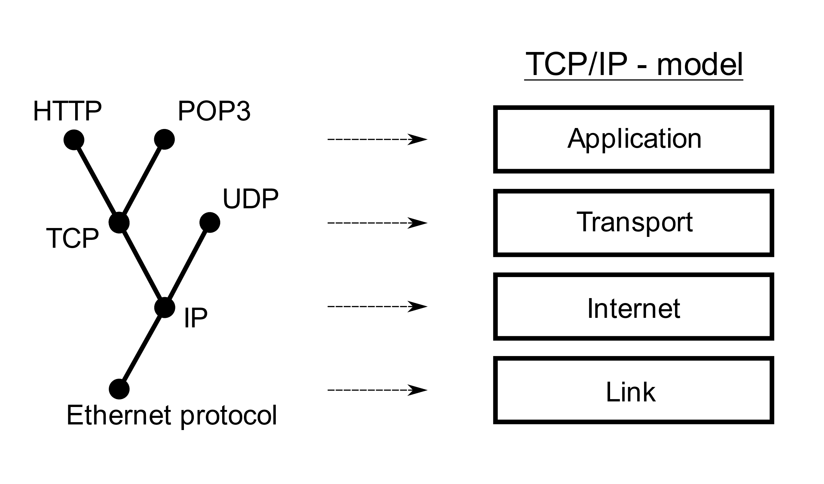
The Basic: WWW
Tim Berners-Lee approx. 1989 - 1990
Task: Sharing research documents at CERN
Solution:
Hypertext protocol over TCP/IP for retrieving documents
Actually very simple text based format

Slide 6
The Basis: HTTP
HTTP = Hyper Text Transfer Protocol
Application Protocol for Distributed Information Systems
Exchanging information between clients and server
Has four parts
Verbs: GET, POST, PUT, DELETE
Corresponds to normal database CRUD operations
Standardized data formats
Media types: text/html, image/gif, application/json
Message format in text
Verb + Headers (key/value) + empty line + body
Standard Error Code Vocabulary
200 OK, 404 NOT FOUND, 201 CREATED, …

Slide 7
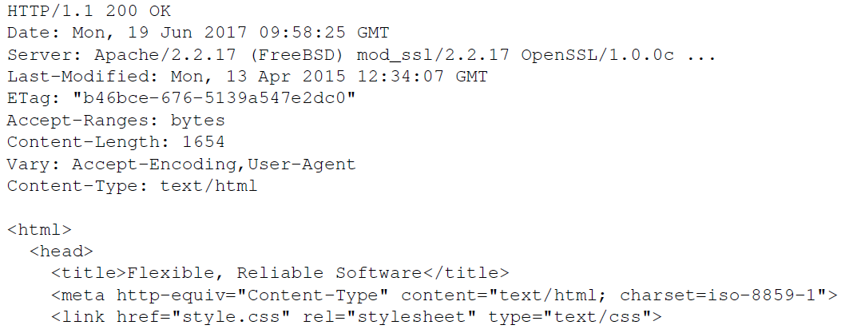
Message Format
Text format !
Request line
Verb resource HTTP version
Header key-values
Reply line
Status line
HTTP codes
Header fields
Message body

Slide 8
Roy Fielding’s work
Goal: Keep the scalable hypermedia properties of WWW
REST = REpresentational State Transfer
Transferring a representation of data in a format matching one of standard data types (media types)
Resource: any information that can be named
Identified by a resource identifier
URI = Uniform Resource Identifier
Interactions are stateless
Each request contains all the information necessary
Exercise: Why is everybody so keen on ‘stateless’? What QA is involved?

Slide 9
Resource Identifier: URI
URI: Uniform Resource Identifier
URL = URI in which resource location and means are defined
http://www.baerbak.com/contact.html
http://localhost:4567/bin
Exercise: Identify the parts of the URI

Slide 10
CRUD by REST
I can now design an Information System using the REST style. Example ‘a clipboard web server
POST on /pastebin/ with a message body
= CREATE a new clip (resource) on the clipboard, assign resource ID
GET on /pastebin/100
= READ the stored clip in the provided resource ID
PUT on /pastebin/100 with a complete new message body
= UPDATE the contents of the resource
DELETE on /pastebin/100
= you get it ☺

Slide 11
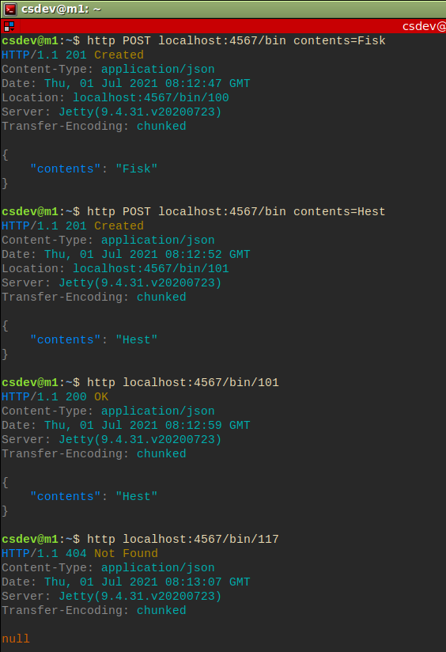
Demo
POST ‘Fisk and ‘Hest’ in bins
Assigned bin 100, 101
GET bin 101
Which is ‘Hest’
GET bin 117
Which is not found (404)

Slide 12
HATEOAS
One drawback of REST compared to other programming models
In oo/procedural/functional you can define methods that do complex algoritms over multiple objects/”resources”
Not just: create, read, update, delete
Solution: Hyper Text As The Engine Of Application State
Any resource contains not just its state but also links that may modify state of related resources
Read FRS §7. HATEOAS is beyond our MSDO scope…

Slide 13
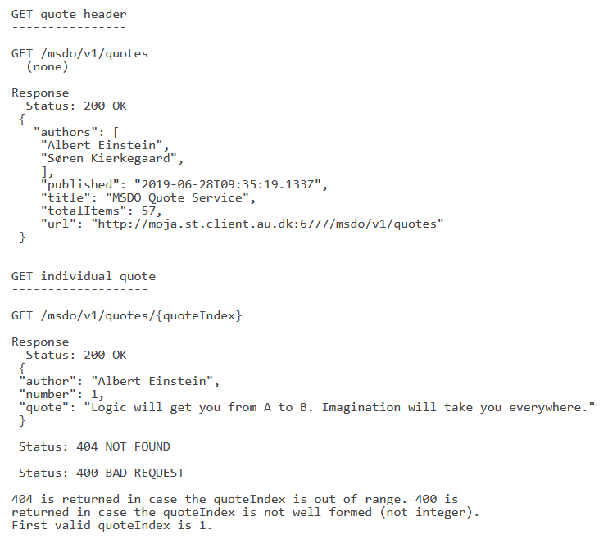
Define the API
FRDS §7.7 presents a rough template for API definition
Example
Will be used in MSDO
Or use swagger or …

Slide 14
The Slow Version

Slide 15
HTTP & ReST
The Broker pattern had its glory in the early 1990’ies as a paradigm for distributed communication
However, the WWW sort of happened in the same period.
And soon it was realized that HTTP could do much more than just provide web pages…

Slide 16
HTTP

Slide 17
WWW
Tim Berners-Lee approx. 1989 - 1990
Task: Sharing research documents at CERN
Solution:
Hypertext protocol over TCP/IP for retrieving documents
Actually very simple text based format

Slide 18
Just a Note
Web, world wide web, HTML, HTTP may seem like one big jumble but they are distinct concepts though they were developed in parallel. They have different roles to play.
HTML: Hypertext Markup Language is a dataformat, useful for visual formatting of text document containing images and references (hyperlinks) to ther documents.
HTTP: Hypertext Transfer Protocol is an application protocol for distributed information systems.
WWW: The system made that used HTML+HTTP to share documents at CERN, and later – quite a few other places ☺

Slide 19
Message Format
Text format !
Request line
Verb resource HTTP version
Header key-values
Reply line
Status line
HTTP codes
Header fields
Message body

Slide 20
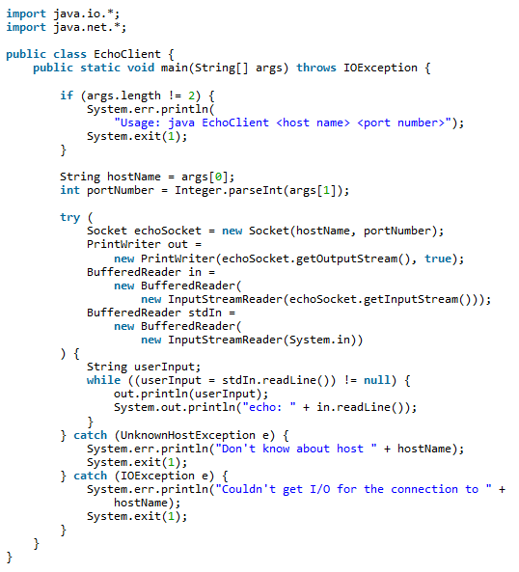
Write your Own Web Client
Exercise in class:
Write a web client
Notes:
What should be altered to get a web page?

Slide 21
URI / URL
URI: Uniform Resource Identifier
URL = URI in which resource location and means are defined
http://www.baerbak.com/contact.html
http://localhost:4567/bin
Exercise: Identify the parts of the URI

Slide 22
HTTP Verbs
Http version 1.1. defines 4 verbs (ok, some more…)
… which are basically the database verbs
CRUD Create, Read, Update, Delete
These form the core of the REST architectural style…

Slide 23
GET
GET is the ‘first and original verb’, and the one most traffic uses on WWW
Browing web pages
Or even make searches on the web server
GET is idempotent
Call once or 100 times, the output is the same
It is an ‘accessor’ / ‘query’ method!

Slide 24
POST
POST means ‘create’
That is, create new resources/information on the server
It is a ‘mutator’/’command’ method
Consider ‘telemed.processAndStore(obs);’
Command pattern: Convert method call to an object
Now, consider that ‘telemed is on the server side
POST allows us to create a command object
POST /telemed HTTP/1.1
Body { method: ‘processAndStore’, argument: {‘sys’:140, …} }

Slide 25
PUT, DELETE
PUT means ‘update’
That is, given an existing resource, overwrite its information with updated information (*)
Mutator ☺
DELETE means ‘delete’ ☺
That is, remove an existing resource from the server
(*) unless you only provide a partial ressource, then you should update using POST instead (which IMO does not make sense, but…)

Slide 26
Failures in Distribution
A lot of things can and will go wrong in distributed systems
The server has crashed
The network has crashed
Server does not understand what you talk about
You do not have the proper authorization
We normally use exceptions to signal failures
But – does not work over networks ☹
The old way: Error codes

Slide 27
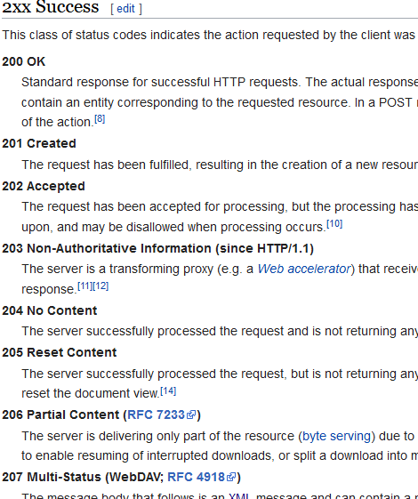
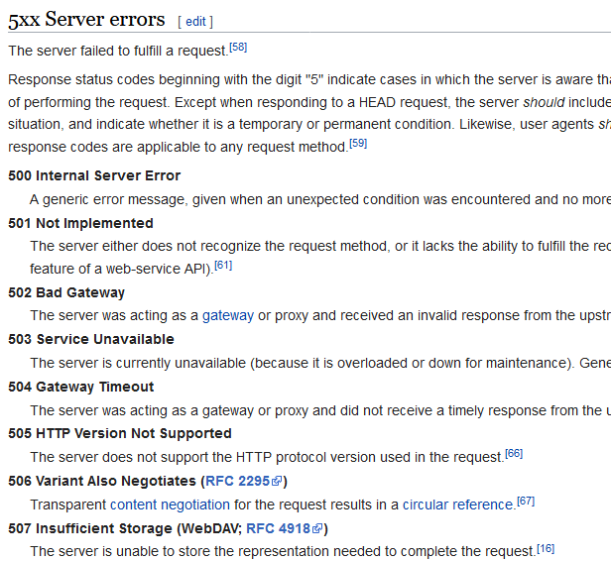
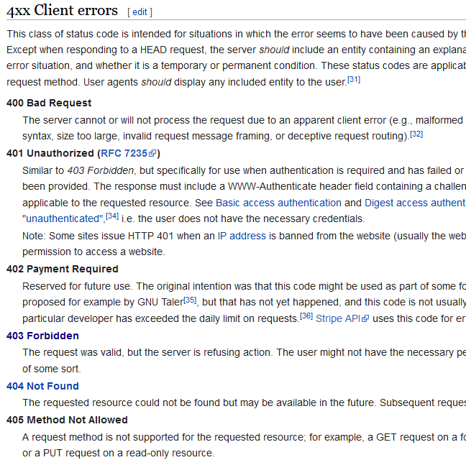
HTTP Status Codes
Well defined vocabulary of error codes! See Wikipedia

Slide 28
Media Types
The requestor and the replier need to agree on the dataformat that data is exchanged in
Media types, defined by IANA
Internet Assigned Number Authority
Well known types
text/html: HTML formatted text
image/gif: Image in the GIF format
application/xml: XML format
application/json: JSON format
I want HTML, please

Slide 29
REpresentation State Transfer

Slide 30
What is REST
As a software architect, I see it as an
Architectural style / pattern
It is simply quite another programming model
Functional programming:
Computation is passing data through chains of functions
Object programming:
Computation is community of objects passing messages
RPC over Client-Server:
Computation is clients invoking procedures on remote servers
REST
Computation is clients manipulating resources using CRUD ops and moving through states using hypermedia links

Slide 31
Programming Model
Broker pattern
Supports RPC/RMI between clients and servers
State changes through accessors and mutator methods
Any interface is possible
REST
Supports only CRUD on remote resources (=Data objects)
Supports workflow through hypermedia links
Very different programming model required compared to RPC
Not all architectures are suited for REST !

Slide 32
Roy Fielding’s work
Goal: Keep the scalable hypermedia properties of WWW
REST = REpresentational State Transfer
Transferring a representation of data in a format matching one of standard data types (media types)
Resource: any information that can be named
Identified by a resource identifier
URI = Uniform Resource Identifier
Interactions are stateless
Each request contains all the information necessary
Exercise: Why is everybody so keen on ‘stateless’? What QA is involved?

Slide 33
Representing Resources
Using TeleMed as case

Slide 34
Example
Resource: Inger’s blood pressure measured on 29/6/2017
Representation of data using standard media type:
{ pid: ”251248-1234”, sys: 120.0, dia:70.0 } (json)
Resource identifier
http://telemed.org/bp/251248-1234/made-29-06-2017-09-59-17
I.e. Inger’s resource (her blood pressure measurement) is uniquely identified using this URI

Slide 35
Example: CRUD
Inger makes the measurement CREATE
POST /bp
Body: { pid: ”251248-1234”, sys: 120.0, dia:70.0 }
Response
StatusCode: 201 CREATED
Location: /bp/251248-1234/made-29-06-2017-09-59-17
Body: { pid: ”251248-1234”, sys: 120.0, dia:70.0, status: ”new” }
Meaning
The resources was created, has resource id
/bp/251248-1234/made-29-06-2017-09-59-17

Slide 36
Example: CRUD
Inger reviews the measurement READ
GET /bp/251248-1234/made-29-06-2017-09-59-17
Body: (none)
Response
StatusCode: 200 OK
Body: { pid: ”251248-1234”, sys: 120.0, dia:70.0, status=”new” }
Meaning
The resources was found, and the measurement returned

Slide 37
Example: CRUD
Inger updates the measurement UPDATE
PUT /bp/251248-1234/made-29-06-2017-09-59-17
Body: { pid: ”251248-1234”, sys: 126.0, dia:69.0 }
Response
StatusCode: 201 CREATED
Body: { pid: ”251248-1234”, sys: 126.0, dia:69.0, status=”revised” }
Meaning
The resources was found, and the measurement updated

Slide 38
Example: CRUD
Inger deletes the measurement DELETE
DELETE /bp/251248-1234/made-29-06-2017-09-59-17
Body: (none)
Response
StatusCode: 204 No Content
Body: none
Meaning
The resources was found, and the measurement deleted

Slide 39
Prototype: pastebin
REST is pretty lightweight programming wise…
Goal: AP to demonstrate ”pastebin”
Online service for storing text messages = ‘post-its’
Total time: 1.5 hour (well – a bit cheating)
Developed
Webserver, accepting POST and GET
Using Spark-java framework (IPC) and GSON (Marshaling)
Client: curl or httpie ☺
Notes:
1.5 hours was a bit cheating, I already had some boilerplate code hanging around…

Slide 40
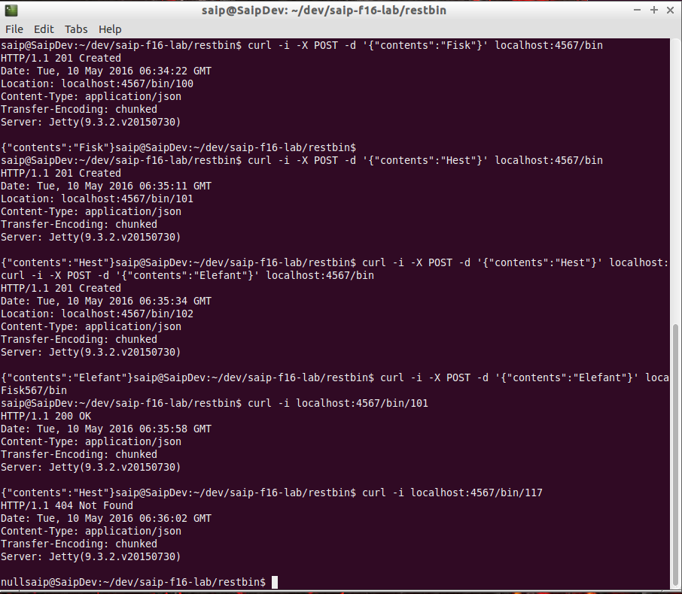
Demo
POST ‘Fisk’, ‘Hest’ and ‘Elefant’ in bins
Assigned bin 100, 101, 102
GET bin 101
Which is ‘Hest’
GET bin 117
Which is not found (404)
Or use ‘httpie’:
http POST localhost:4567/bin contents=Fisk

Slide 41
Note
POST of course needs to tell client the resource identifier of the newly created object!
Reponse contains ‘Location’ field

Slide 42
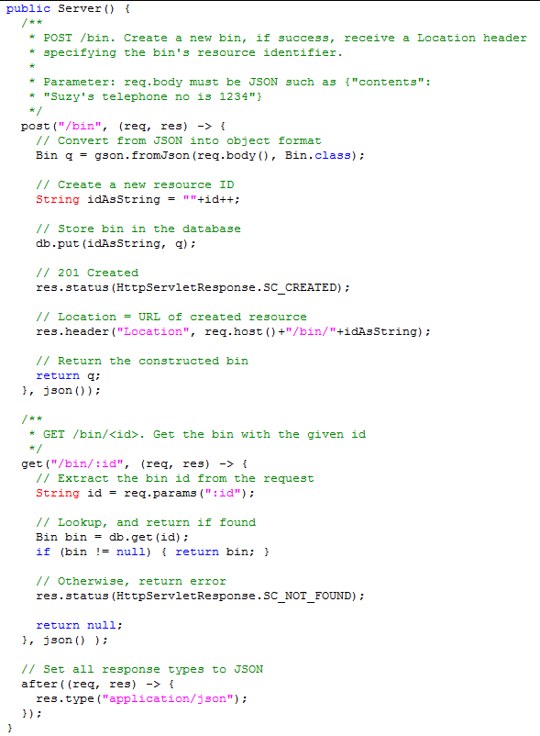
Server code
A PasteBin server in 50 lines of Java
OK, Spark-java helps quite a bit!
Is in the ‘FRDS.Broker’ codebase.

Slide 43
Left as an Exercise
We should be able to update a text in pastebin
PUT verb
And delete an entry
DELETE verb

Slide 44
Discussion
REST uses the HTTP as designed
CRUD verbs and Status Codes (methods, return type)
Virtually allows all Information Systems operations !
URLs as resource identifiers (location+object)
Always identify the same resource, and representation of state is always communicated
Well defined data representations (media types)
JSON has become favorite (readable + small footprint)

Slide 45
Richardson’s Maturity model
From low maturity to high maturity
URI Tunnel
Just use HTTP as IPC layer
SOAP, WSDL, WebServices
And our URI Tunnel Broker!
HTTP
Use CRUD Verbs on resources
Hypermedia
Use links to define workflows
Hypermedia
HTTP
URI Tunnel

Slide 46
Level 2 REST

Slide 47
Workflow
Business systems can often be modelled as workflows
CS term: State machines / state graphs ☺
Ex:Book a flight
I search for flights available get list of links
I pick one particular flight get ‘book’ link
I book the flight enter personal details
I pay for the flight enter credit card details
I get a) e-ticket b) receipt get two links

Slide 48
Exercise
I search for flights
What HTTP verb is that? What resources are involved?
I book the flight
What HTTP verb is that? What resources are involved?
I pay for the flight
What HTTP verb is that? What resources are involved?
I get my e-ticket
What HTTP verb is that? What resources are involved?
Notes:
GET /flight return [ {flight:’sk992’, …}, {…]
POST /booking/sk992
body {name: ”henrik”, …}
response: Location /booking/sk992/hbc-sk992
POST /booking/payment/hbc-sk992
body { cardid: ”1234-1234-1234-1234”, …}
response: Location /booking/payment/hbc-sk992
body { etciket: /eticket/hbc-sk992, receipt: /receipt/hbc-sk992

Slide 49
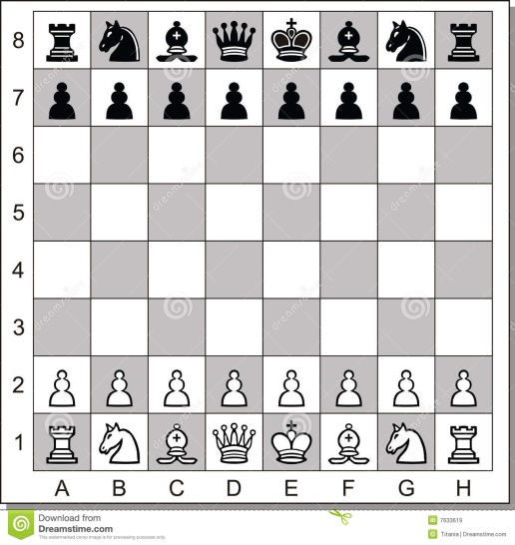
Level 2: Hypermedia
Workflows are not just ‘CRUD a resource’, rather more complex
Transactions: Multiple entities atomically updated
State transitions: Mutator methods that updates several entities and/or updates state
Ex: A game’s move(f,t) method
Validate move (may return ‘not valid’)
Update board state (transaction, e.g. king castling)

Slide 50
Analysis
‘move()’ using HTTP verbs ???
Analysis A:
”No can do”
Because ‘move’ is not a create, it is not a read, nor update, nor delete of a single resource (stateless)

Slide 51
Analysis
‘move()’ using HTTP verbs
Analysis B: Maybe it is an update of game
PUT /game/47
Body: Full board state with the move executed
But – then the server has to infer the move from the delta between state ‘before’ and state ‘after’ which is weird!
And it is definitely not stateless – right?

Slide 52
Analysis
Analysis C: A ‘state transition resource’
Creating a game, is creation of two resources
The game resource /game/47/
The move resource /game/47/move or /game/move/47
PUT /game/47/move
Body: { from: e2, to: e4, player:white}
This will
Try to UPDATE the state => 200 OK or 401 Invalid
If 200 OK, then the game resource is updated
And can be successively GET to see new board state

Slide 53
Challenge
But how do we return two resources from the game create POST message?
We can not, but we can use the WWW way – provide hypermedia links!!!
boardState: [ ... ],

Slide 54
Aka
HATEOAS:
Hypermedia As The Engine Of Application State.
Application state changes are modelled as hypermedia links, each to a resource that objectify the change itself, not the old/new state of underlying objects
A ‘move’ resource, a ‘payment’ resource, a ‘send items to address’ resource, etc.

Slide 55
Often visible in UI
The state changes of the order

Slide 56
Level 2: Hypermedia
So – REST is a radically different architectural pattern/style, different from OO and interface-based paradigms
POST to create a resource
May return several hypermedia links that define valid state transitions for the resource
Which are then manipulated through the HTTP verbs
Makes potential state transitions discoverable
Just like any new web page presents links that I may follow
Hypermedia
HTTP
URI Tunnel

Slide 57
REST versus Broker
Comparing Apples and Bananas?

Slide 58
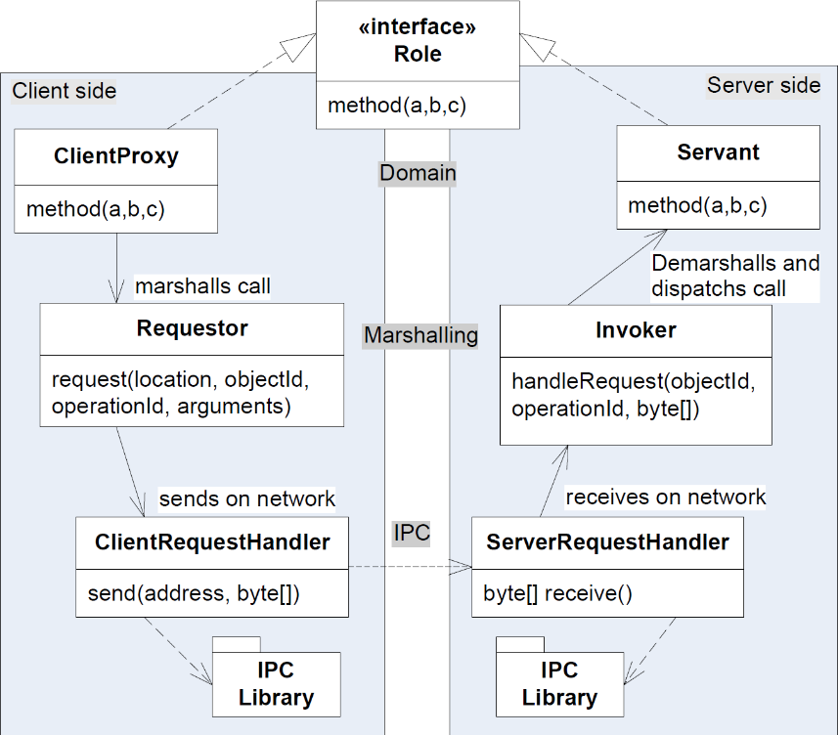
Programming Model
Broker: invoke methods on objects
REST: CRUD methods on resources
Comparing to Broker
REST actually addresses responsibilities on both the Marshalling, Location, and IPC level.
REST has much lower cohesion and tighter binding!

Slide 59
Programming Model
Broker is well supported by tooling
Java RMI, .Net remoting, …
REST is (IMO – or am I missing something) more up to you to code it all
Swagger a.o. can provide templating
REST is much tighter coupled to the HTTP platform
But it is a strong scaleable one, so …

Slide 60
Example
Requirement
Rewrite the ‘cmd-daemon’ protocol to use RabbitMQ message broker
Using FRDS.Broker
A task that takes about 1-2 hours
Using the RPC tutorial of RabbitMQ
Using REST
Rewrite everything from scratch

Slide 61
Summary
UR Tunnelling
Just uses HTTP and web technology/frameworks as the IPC layer in the Broker
That is : transport network packages to/from client and server
REST
Architectural Pattern what deeply exploits HTTPs advantages
Lightweight with less tool support
Focus is on performance and scalability because
True Client-server No callback/observer pattern
Value passing of information

Slide 62
Summary
Broker pattern and REST?
REST and OO are two different architectural styles…

